Slide 1


Project BLOC - Frontline Agentic Orchestration Engine
Team Name: RetailOps AI
Team Leader Name: Lester Alarcon
Target Track: Retail & Commerce / Future of Work (JAPAC Track)
Problem Statement: Solving Frontline Operational Breakdown - Eliminating high turnover, delayed sales visibility, and clunky mobile ERP forms through Multi-Agent AI (Pax, Vera, Nexus), 3-Second Fast-Sale Capture, and Computer Vision Audits.

Slide 2

Note: Please download this template to make your edits and submit the final version.
To download, go to File > Download > Microsoft PowerPoint (.PPTX). Kindly refrain from sending edit requests.

Slide 3
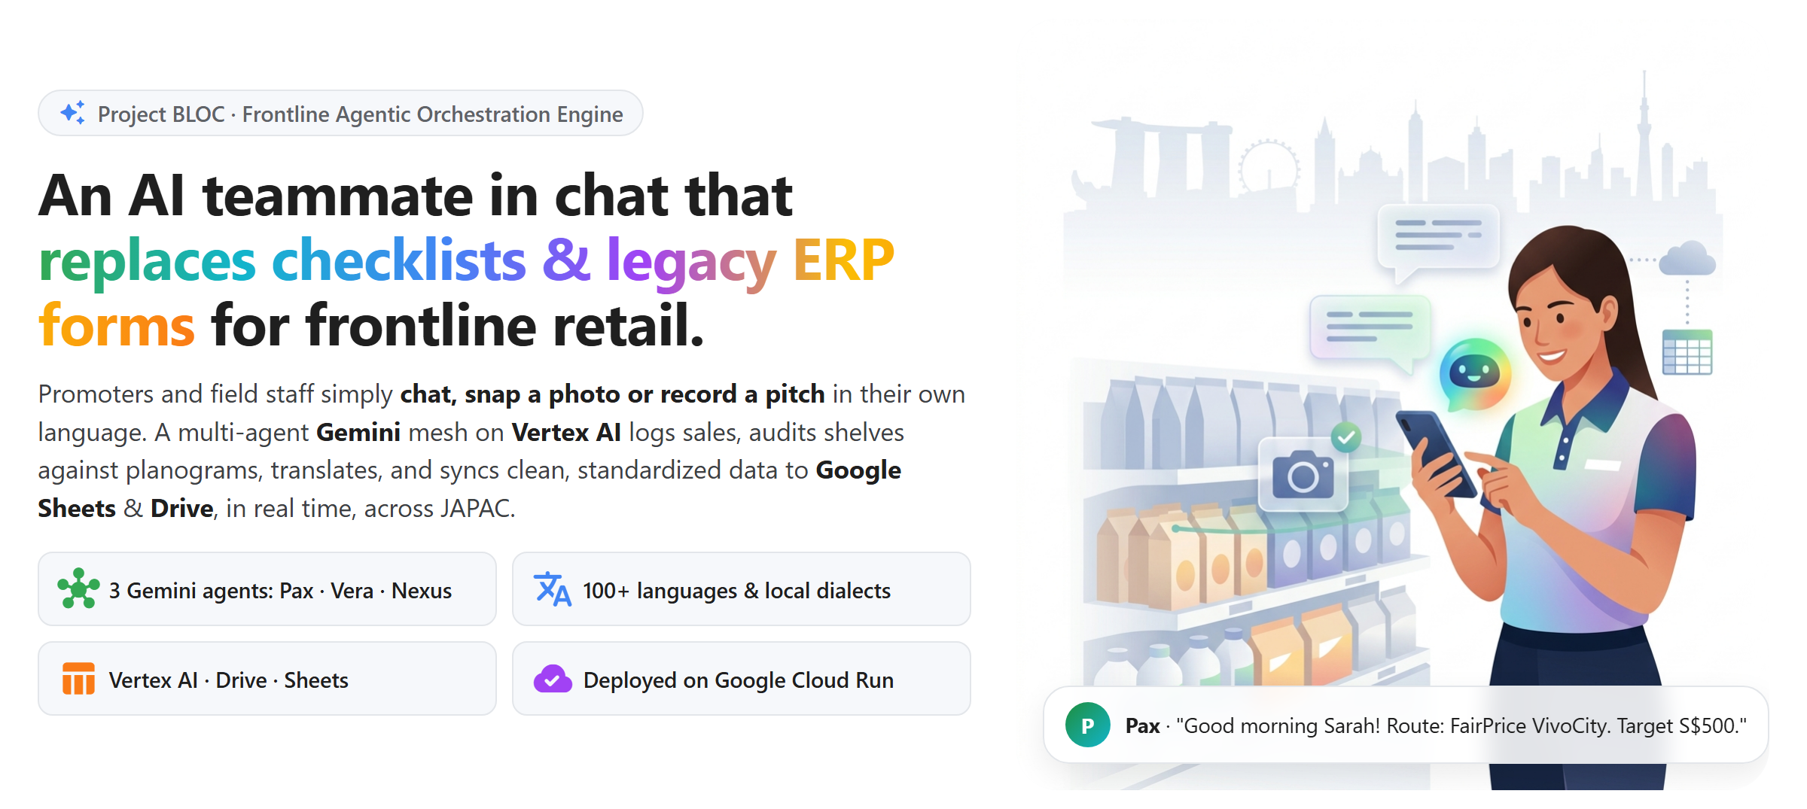
Brief about the idea

Slide 4
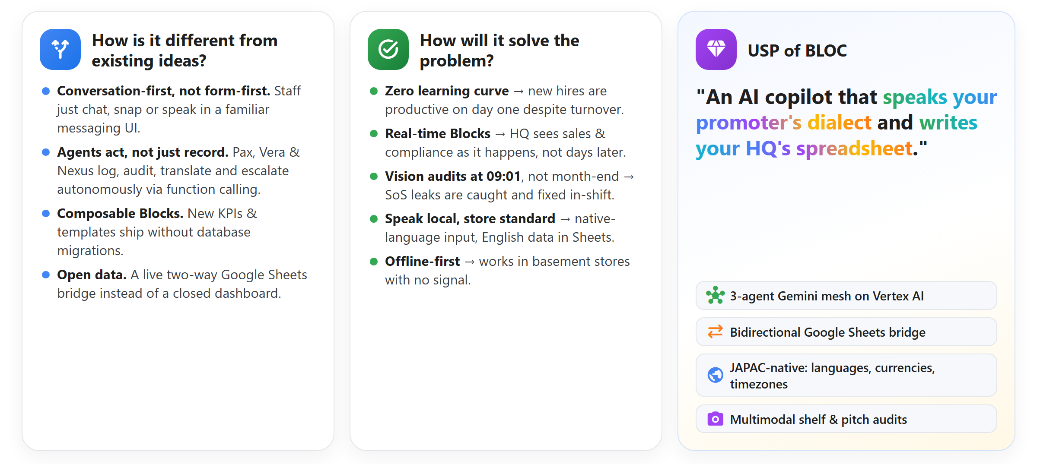
Opportunities
How different is it from any of the other existing ideas?
How will it be able to solve the problem?
USP of the proposed solution

Slide 5
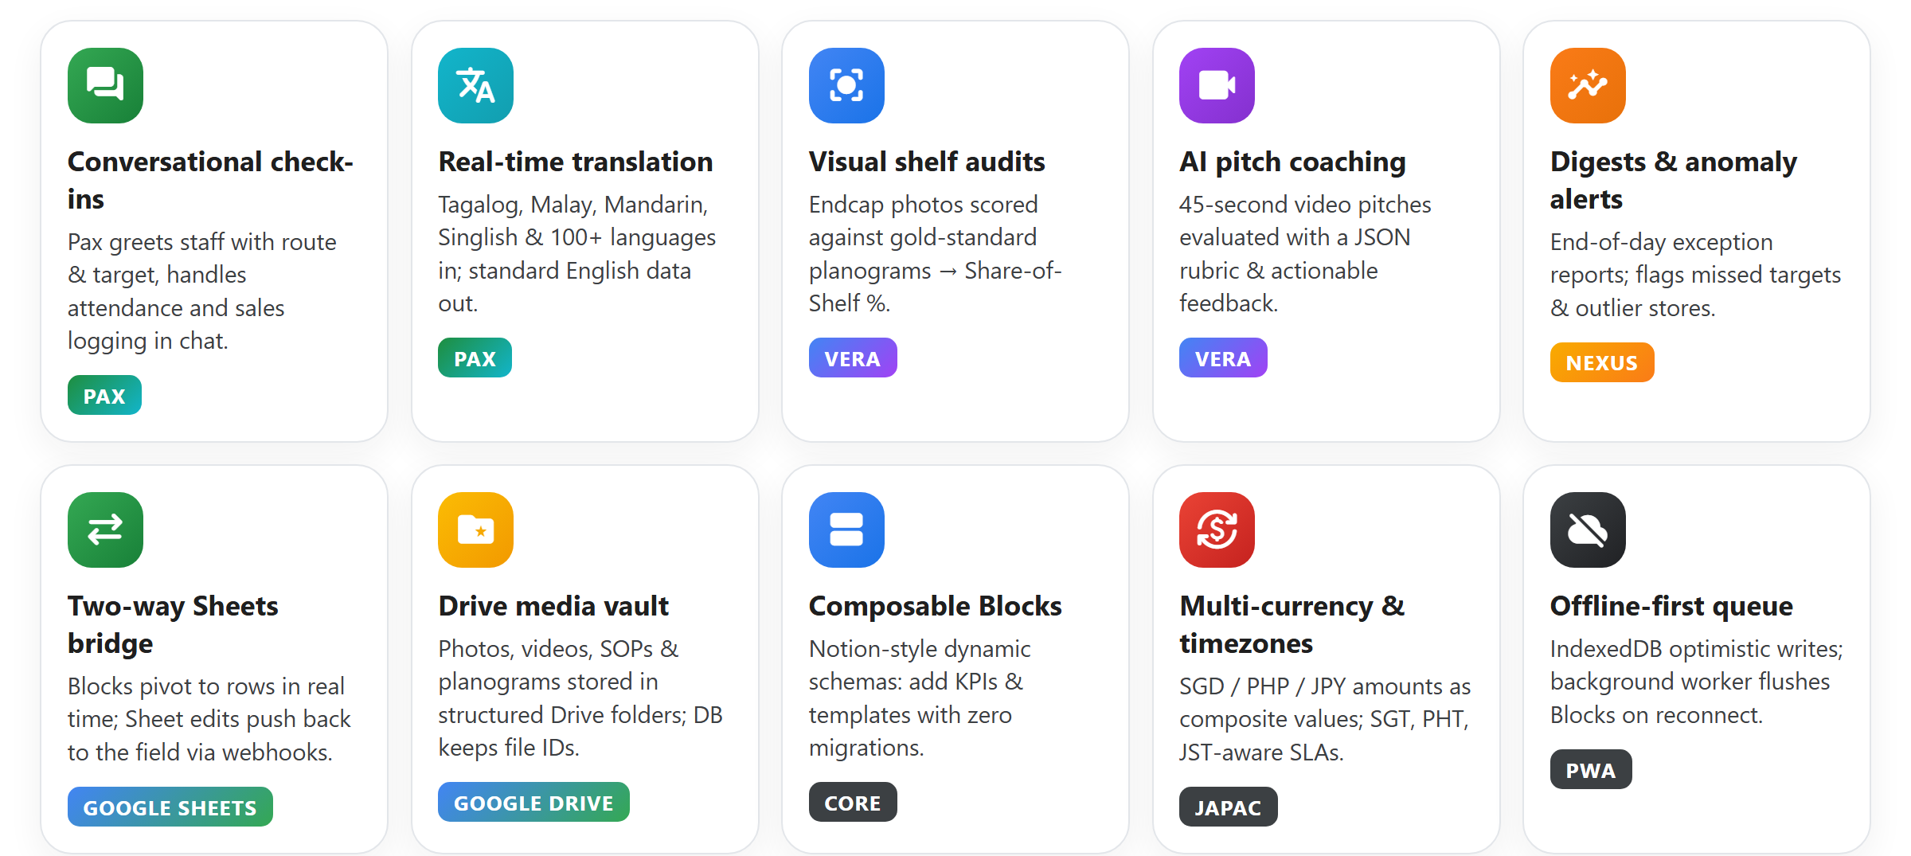
List of features offered by the solution

Slide 6
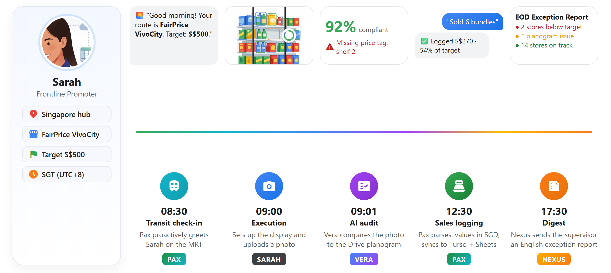
Process flow diagram or Use-case diagram

Slide 7
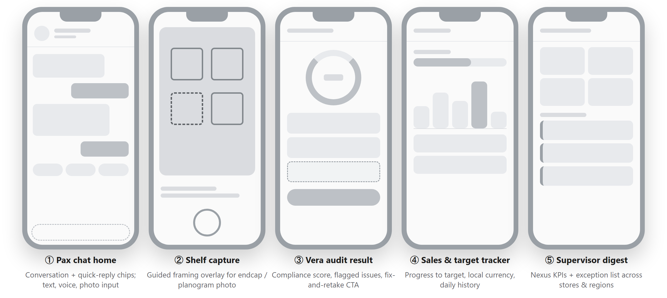
Wireframes/Mock diagrams of the proposed solution (optional)

Slide 8
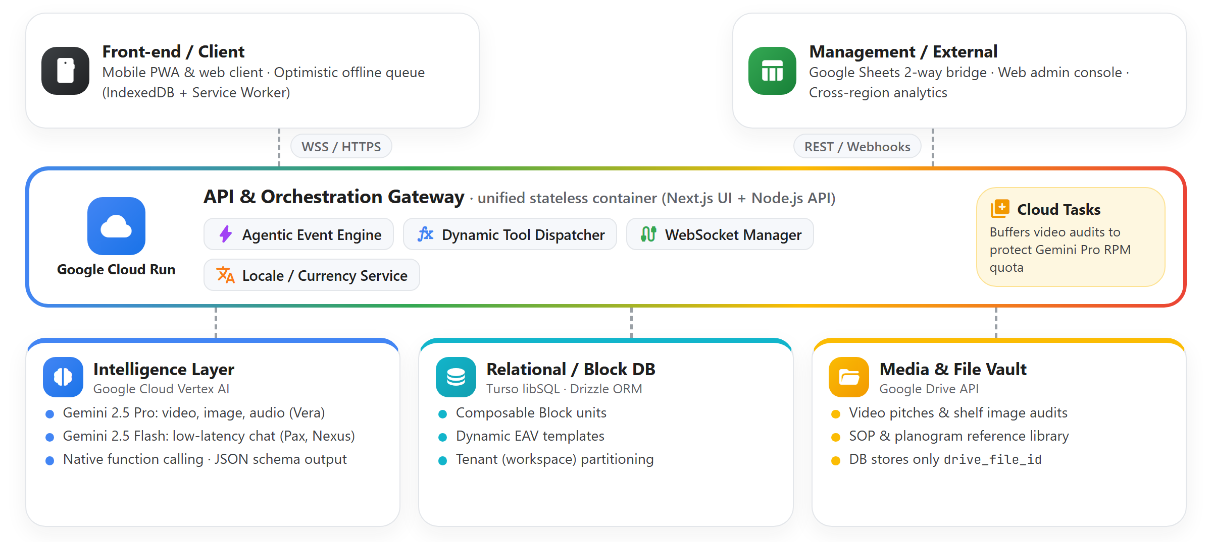
Architecture diagram of the proposed solution

Slide 9
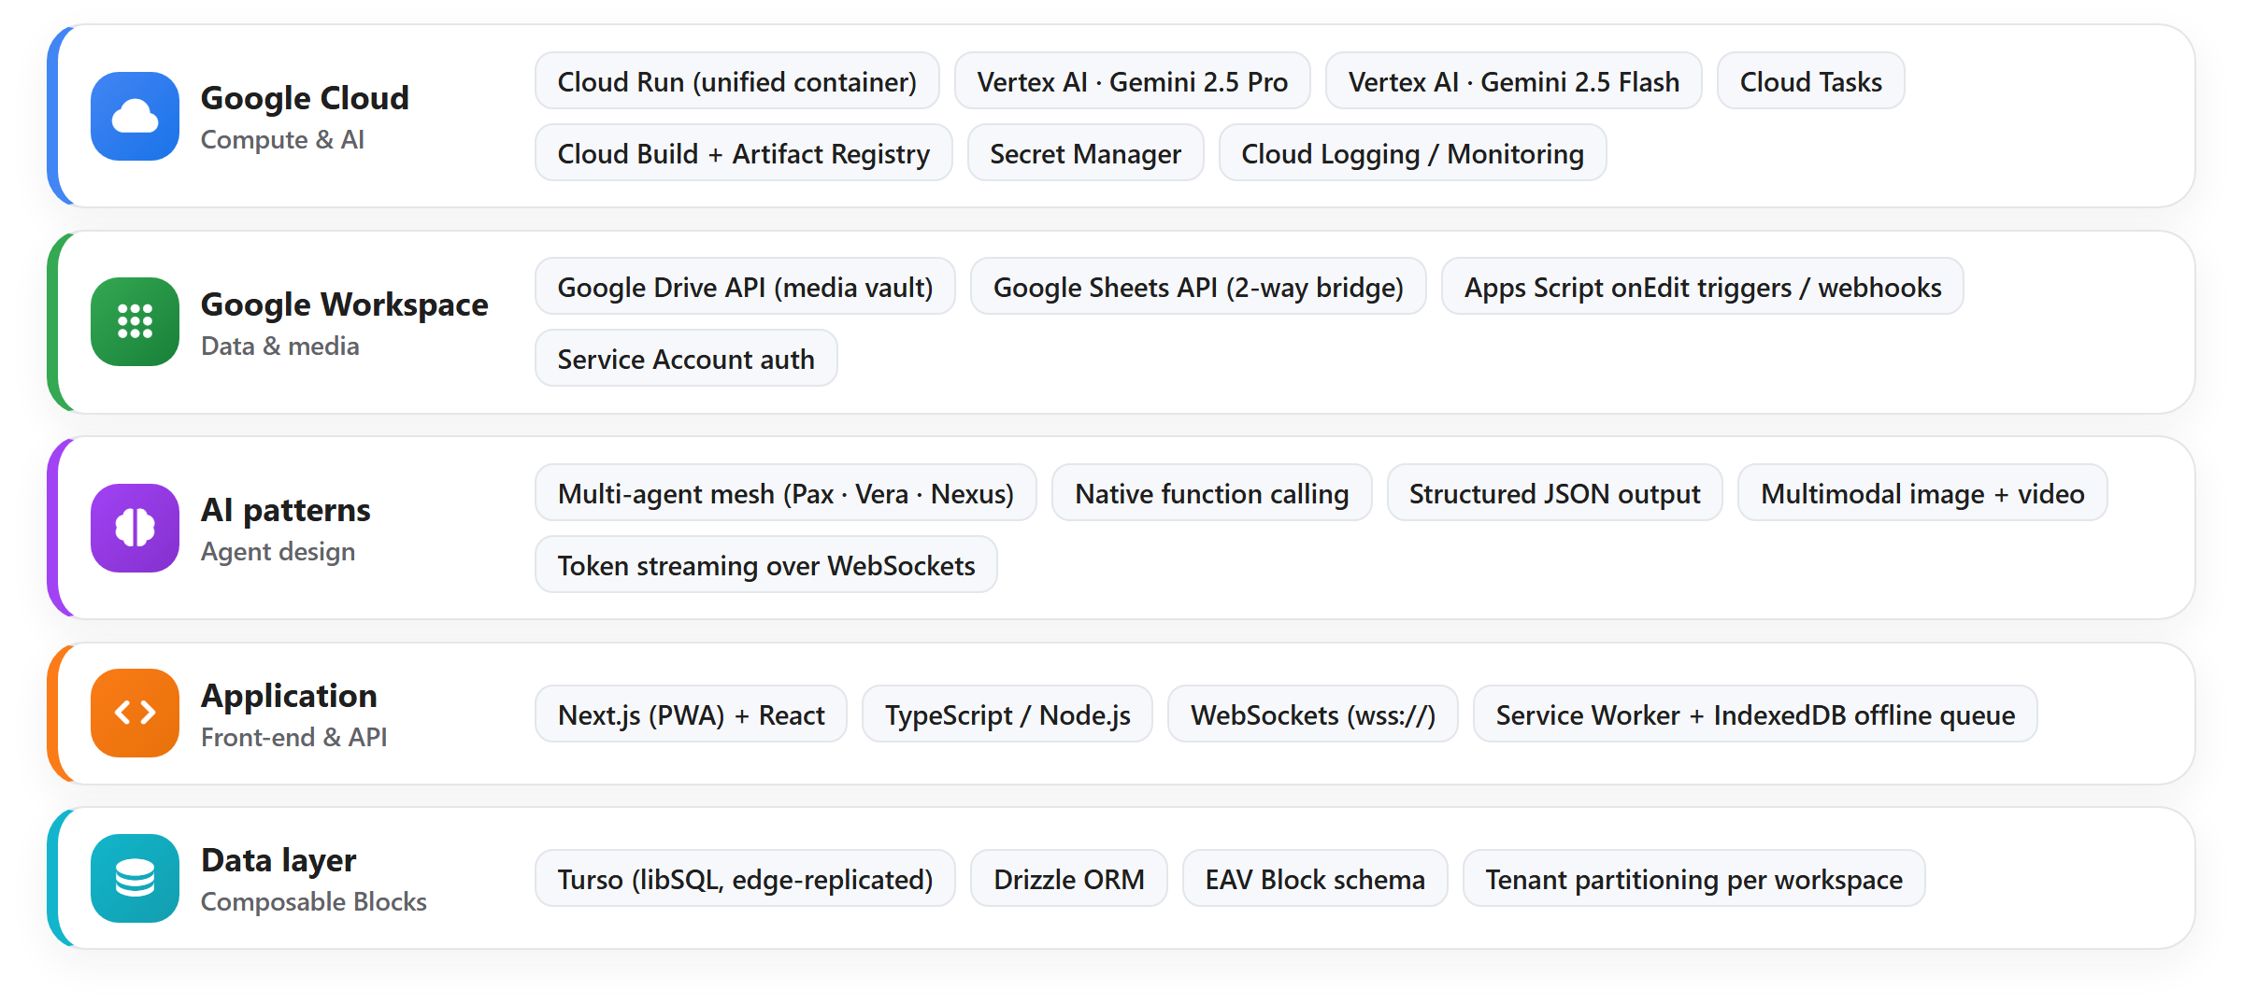
Technologies to be used in the solution

Slide 10
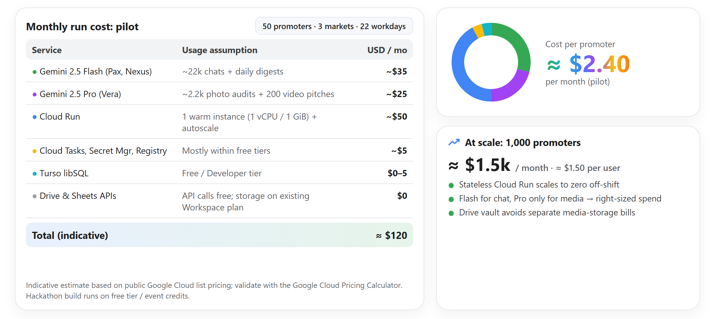
Estimated implementation cost (optional)

Slide 11
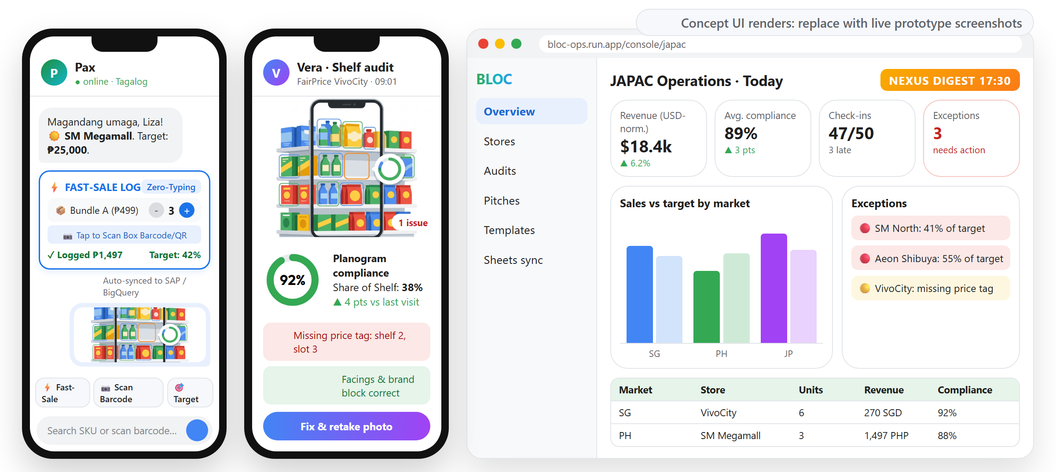
Snapshots of the prototype

Slide 12
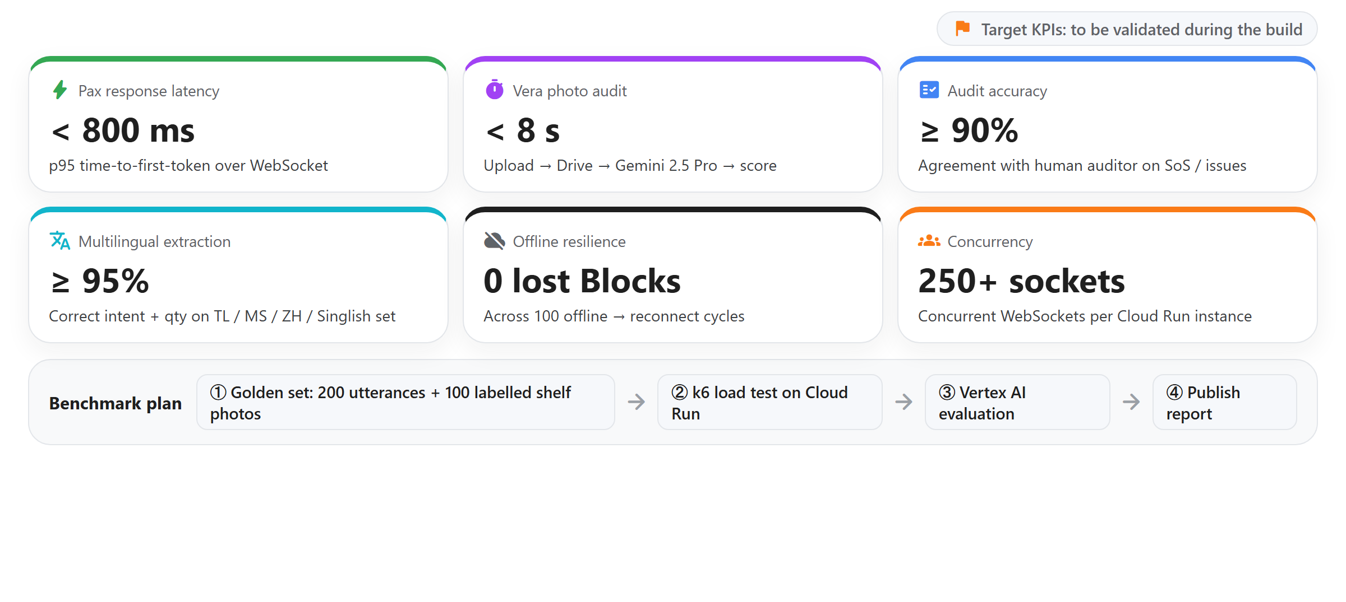
Prototype Performance report/Benchmarking

Slide 13
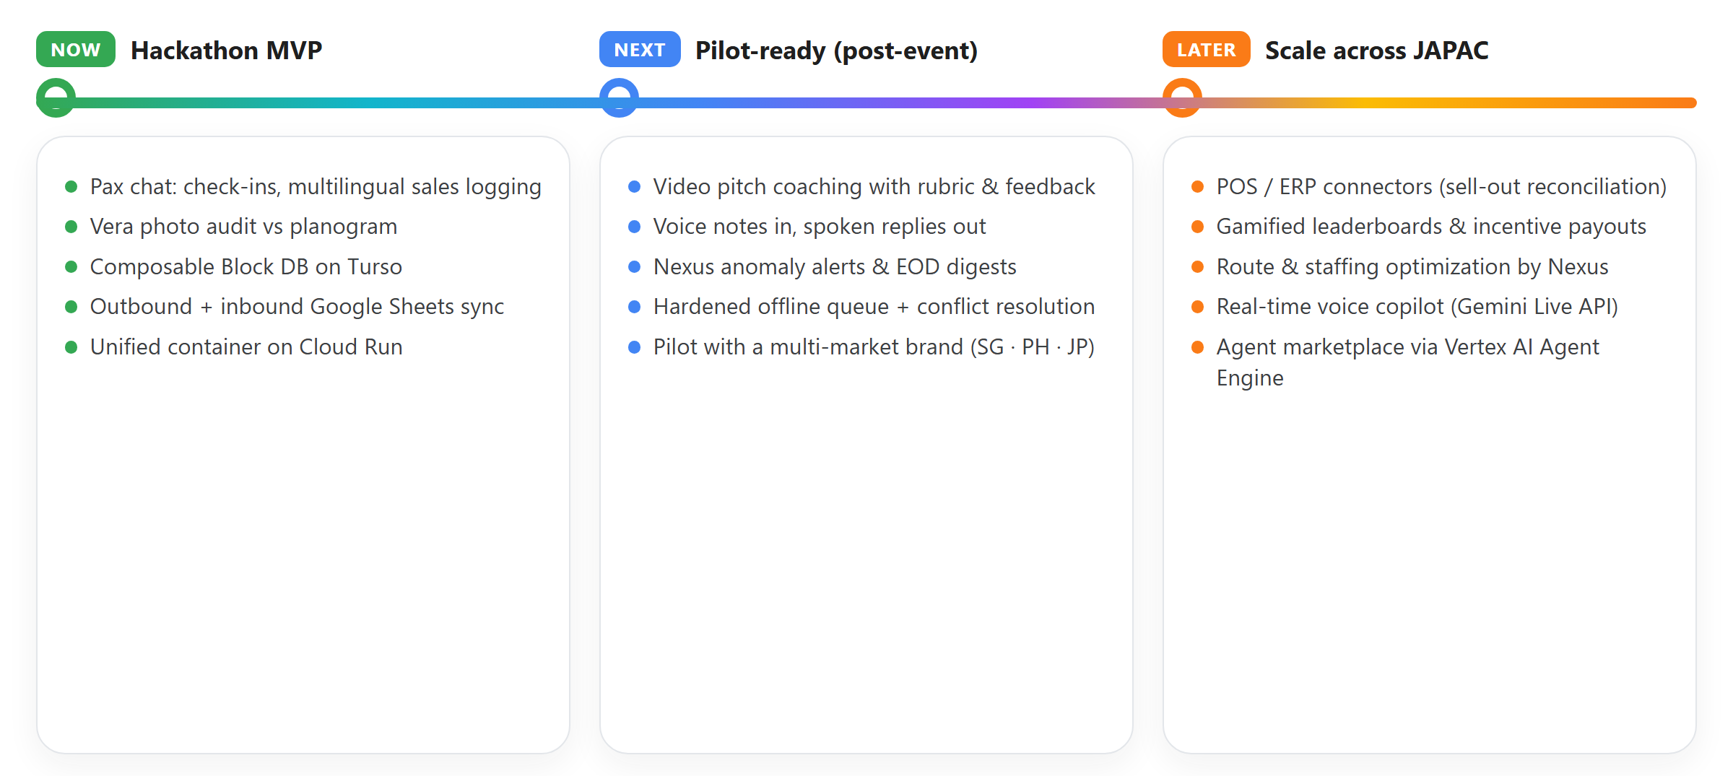
Additional Details/Future Development (if any)

Slide 14
Provide links to your:
GitHub Public Repository
Demo Video Link (3 Minutes)
Final Product Link
â€¢ GitHub Public Repository
Repository URL: https://github.com/retailops-ai/project-bloc
â€¢ Demo Video Link (3 Minutes Pitch & Walkthrough)
Video URL: https://youtu.be/project-bloc-demo-3min
â€¢ Final Product Link (Deployed on Google Cloud Run)
Live App URL: https://bloc-ops.run.app

Slide 15
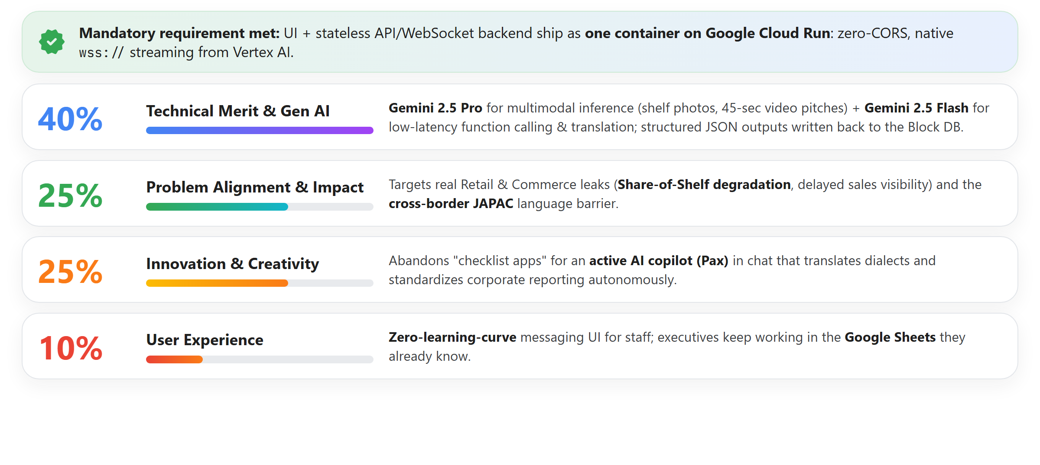

Slide 16


